Slide 1
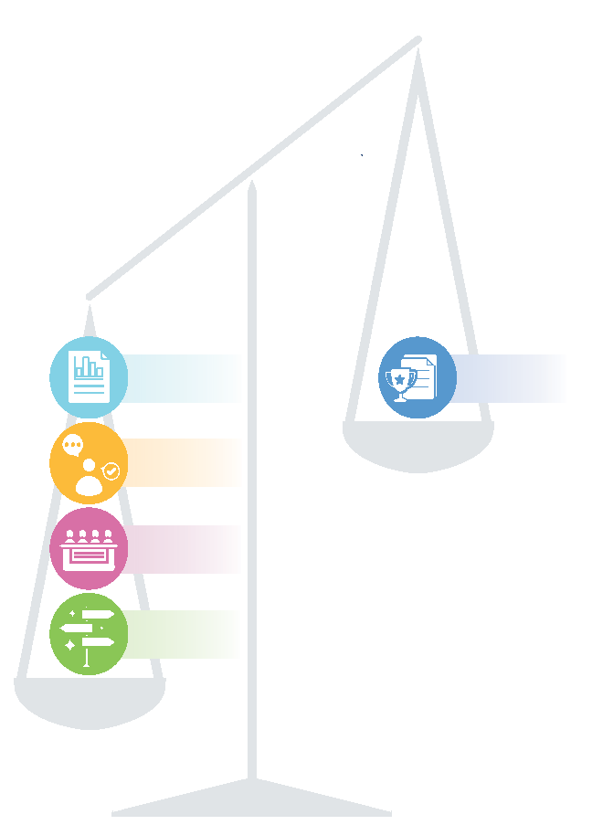
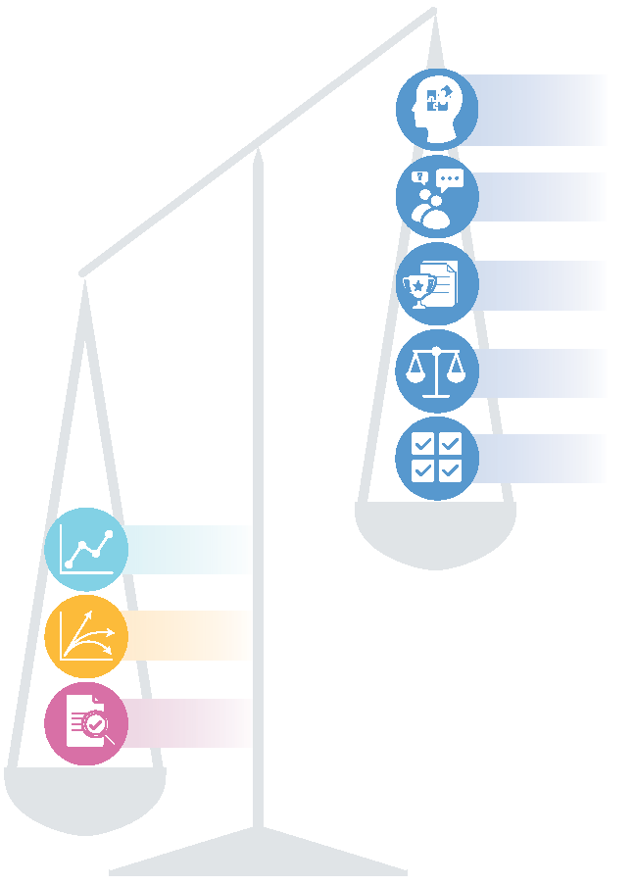
4.13 Weaknesses in many COVID-19 evidence-support systems
‘Other things’ than best evidence that were more typically encountered by COVID-19 decision-makers
(& potential risk)
Forms of evidence that were more typically encountered by COVID-19 decision-makers
Behavioural /
implementation
research
Qualitative insights
(developed
using a robust
process)
Evidence synthesis
Single study
Best evidence
Technology assessment
(developed
using a robust
process)
Guidelines
Expert opinion
Risk of ‘hubcap chasing’ unless each study was quality assessed and then either considered as local (national or sub-national) evidence or put in the context of a living (global) evidence synthesis
Expert panel
Data analytics
Risk of ‘squeaky wheel getting the grease’ unless the expert was asked to share the quality-assessed evidence syntheses on which their opinion was based or to focus on what specific evidence syntheses mean for a given jurisdiction
Jurisdictional scan
Modeling
Risk of GOBSATT (or ‘good old boys sitting around the table’) unless the panel members were asked to share their evidence (as above) or were supported by a robust guideline-development process
Evaluation
Risk of ‘group think’ unless jurisdictions shared their supporting evidence or plans for generating it
1

