Slide 1



0.0 Introduction
Note: full version available in Update 2023
One year since the publication of the report (which is now available in seven language and in multiple formats)
While government policymakers in some countries (like newly elected ones in some Latin American countries) are open to new approaches to decision-making and evidence use, many policymakers, organizational leaders and professionals have largely returned to pre-pandemic approaches
While some funders and donors and some impact-oriented evidence producers have piloted coordination mechanisms, many evidence producers continue to operate without coordination and to generate significant research waste
While many citizens have become more aware of the potential value of evidence, many others have become more distrustful of decision-makers and evidence
    Formalize and strengthen domestic evidence-support systems
    Enhance and leverage the global evidence architecture
    Put evidence at the centre of everyday life
This (first) annual update is focused
on three implementation priorities
Agreed in partnership with the producers of the two other global reports published on this topic in the last 18 months (Cochrane Convenes and the Global Evidence-to-Policy Summit)
Being addressed with the support of the Evidence Commission Implementation Council and three other groups (appendix 1)
Collectively cover 20 of the Evidence Commission’s 24 recommendations and do so as a more actionable package (appendix 2)
Underpinning these three priorities is the growing recognition of how evidence can be used to address societal challenges
(as well as about the many other steps needed to support citizens)
Respond to decision-makers’ questions with the right mix of forms of evidence (versus select forms of evidence)
  Match the forms of domestic evidence to the right step in the decision-making process
  Combine domestic evidence (what has been learned in our country) and global evidence (what has been learned from around the world, including how it varies by groups and contexts), the latter of which is enabled by the global evidence architecture (e.g., Campbell and Cochrane)
Embed evidence in cycles of rapid learning and improvement
Use ‘best evidence’ (versus ‘other things’)
© 2023 McMaster University. All rights reserved. This work is licensed under a Creative Commons Attribution-NonCommercial-ShareAlike 4.0 International License.

Slide 2
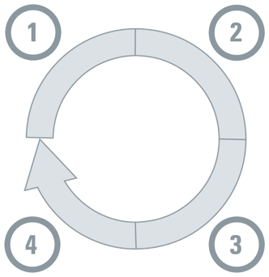





0.1 Respond to decision-makers’ questions with the right mix of forms of evidence
Match the forms of domestic evidence to the right step in the decision-making process
Note: full version available in Update 2023
Understanding a problem and
its causes
Selecting an option for addressing the problem
Forms of evidence
 | Data analytics
 | Modeling
 | Qualitative insights
Forms of evidence
 | Modeling
 | Evaluation
 | Qualitative insights
Monitoring implementation and evaluating impacts
Identifying implementation considerations
Forms of evidence
 | Data analytics
 | Evaluation
 | Qualitative insights
Forms of evidence
 | Behavioural/ implementation research
 | Qualitative insights
© 2023 McMaster University. All rights reserved. This work is licensed under a Creative Commons Attribution-NonCommercial-ShareAlike 4.0 International License.

Slide 3




0.1 (continued) Respond to decision-makers’ questions with the right mix of forms of evidence
Match the forms of domestic evidence to the right step in the decision-making process
Note: full version available in Update 2023
Vantage point |  | Forms of evidence |  | Steps where it adds the greatest value
Domestic evidence |  |  | Data analytics
 |  |  | Modeling
 |  |  | Evaluation
 |  |  | Behavioural/ implementation research
 |  |  | Qualitative insights
© 2023 McMaster University. All rights reserved. This work is licensed under a Creative Commons Attribution-NonCommercial-ShareAlike 4.0 International License.

Slide 4









0.2 Respond to decision-makers’ questions with the right mix of forms of evidence
(versus select forms of evidence that get a lot of attention now)
Note: full version available in Update 2023
Modeling
Behavioural/
implementation
research
Qualitative
insights
Evidence
synthesis
Technology
assessments
Data
analytics
Guidelines
Evaluation
© 2023 McMaster University. All rights reserved. This work is licensed under a Creative Commons Attribution-NonCommercial-ShareAlike 4.0 International License.

Slide 5



0.2 (continued) Respond to decision-makers’ questions with the
right mix of forms of evidence
Combine domestic evidence (what has been learned in our country) and global evidence
(what has been learned from around the world, including how it varies by groups and contexts)
Note: full version available in Update 2023
Vantage point |  | Forms of evidence
Global evidence |  |  | Evidence synthesis | An evidence synthesis: systematically and transparently identifies, selects, assesses and synthesizes the evidence addressing a specific question includes explicit quality assessments (and doesn’t accept a journal’s peer review as synonymous with quality) and can itself be assessed for quality (and quality ratings are included in many evidence-synthesis databases like Social Systems Evidence) can address any question and synthesize any type of evidence can also describe how much certainty we have about particular findings
Vantage point |  | Forms of evidence
Domestic recommendations or evidence support informed by domestic and global evidence |  |  | Technology assessment/ cost-effectiveness analysis
 |  |  | Guideline
© 2023 McMaster University. All rights reserved. This work is licensed under a Creative Commons Attribution-NonCommercial-ShareAlike 4.0 International License.

Slide 6








0.3 Another way of approaching the use of evidence:
Embed evidence in cycles of rapid learning and improvement
(e.g., for climate adaptation, education and health)
Questions
Stocks of existing evidence:
Note: full version available in Update 2023
Where are system gaps and what’s driving them? Where are the inequities? What priorities are we addressing (or what problems are we solving)?
Data analytics
Modeling
Qualitative insights
Evidence synthesis
Make sense of ‘market’ &
population, and then prioritize
Evaluation
Modeling
Qualitative insights
Evidence synthesis
Technology assessments
Guidelines
Co-design new services & service models
What evidence-informed solutions exist? How will solutions be adapted/designed with input from system users and communities?
Behavioural/
implementation research
Qualitative insights
Evidence synthesis
Flows of new evidence:
Data analytics
Evaluation
Implement,
and then adapt
using system-level monitoring
& evaluation
Does this model work?
How & for whom? What adaptations are needed to cement & scale?
© 2023 McMaster University. All rights reserved. This work is licensed under a Creative Commons Attribution-NonCommercial-ShareAlike 4.0 International License.
First two columns adapted from Reid R, Wodchis W, Lee-Foon N, and
Institute for Better Health-Trillium Health Partners (2022)

Slide 7
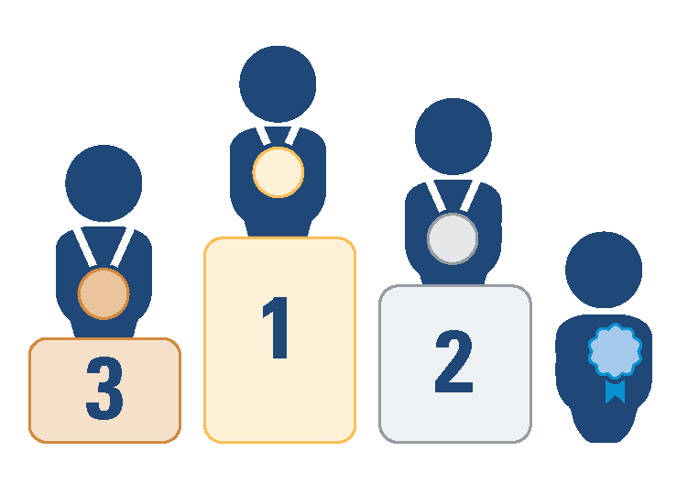






0.4 Use best evidence (vs other things that get a lot of attention now),
and the specific example of expert panels
Note: full version available in Update 2023
If Australia can go for the gold with its national health guidelines, why can’t we do it in our country and for other sectors?
Single studies (or preprints) that haven’t been appraised for quality and placed alongside all other studies addressing the same question
Gold
Expert panels that:
convene people with the right mix of issue-specific knowledge, evidence-appraisal expertise, and lived experience
follow rigorous processes to develop their recommendations (e.g., pre-circulate evidence summaries and clarify what evidence and experiences underpin the recommendations)
adjust their recommendations as the context, issues and evidence evolve (in the case of living expert panels)
Squeaky-wheel experts who don’t speak in a way that make it possible to judge their accuracy
Old-school expert panels using a GOBSATT approach
Best evidence for the type of question being asked
Citizen- and stakeholder-engagement processes that don’t provide ‘ways in’ for evidence
Will never make it to the podium
Expert panels using a GOBSATT (good old boys sitting around the table) approach
© 2023 McMaster University. All rights reserved. This work is licensed under a Creative Commons Attribution-NonCommercial-ShareAlike 4.0 International License.

