Slide 1
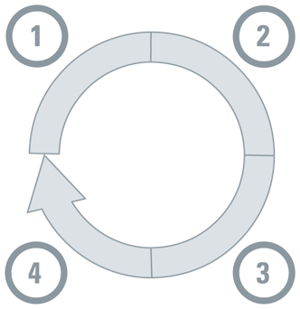
0.1 Respond to decision-makers’ questions with the right mix of forms of evidence Match the forms of domestic evidence to the right step in the decision-making process
Note: full version available in Update 2023
Understanding a problem and
its causes
Selecting an option for addressing the problem
Forms of evidence
 | Data analytics
 | Modeling
 | Qualitative insights
Forms of evidence
 | Modeling
 | Evaluation
 | Qualitative insights
Monitoring implementation and evaluating impacts
Identifying implementation considerations
Forms of evidence
 | Data analytics
 | Evaluation
 | Qualitative insights
Forms of evidence
 | Behavioural/ implementation research
 | Qualitative insights
© 2023 McMaster University. All rights reserved. This work is licensed under a Creative Commons Attribution-NonCommercial-ShareAlike 4.0 International License.

Slide 2
0.1 (continued) Respond to decision-makers’ questions with the right mix of forms of evidence Match the forms of domestic evidence to the right step in the decision-making process
Note: full version available in Update 2023
Vantage point |  | Forms of evidence |  | Steps where it adds the greatest value
Domestic evidence |  |  | Data analytics
 |  |  | Modeling
 |  |  | Evaluation
 |  |  | Behavioural/ implementation research
 |  |  | Qualitative insights
© 2023 McMaster University. All rights reserved. This work is licensed under a Creative Commons Attribution-NonCommercial-ShareAlike 4.0 International License.

